Slide 1
Early Intervention Investment Framework, and lessons for bottom-up wellbeing analysis for budgets
OECD World Forum on Well-being
Matt Donoghue – Director
Treasury and Finance (Victoria)
5 November 2024

Slide 2
Acknowledgement of Country

Slide 3
Background of EIIF

Slide 4
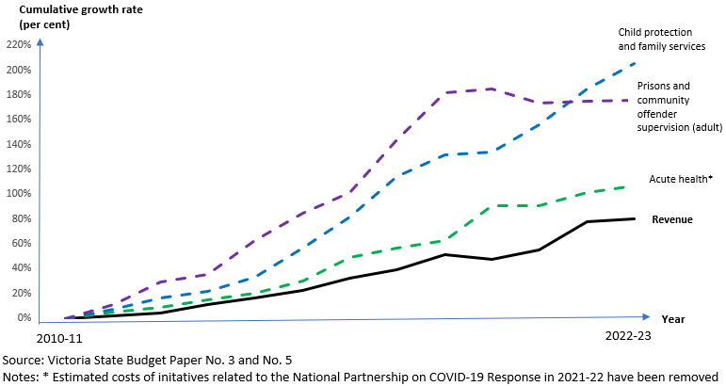
The Early Intervention Investment Framework (EIIF) is focused on evidence-based investment
Growth in acute expenditure outpacing government revenue
Early intervention initiatives made up a smaller share of government funding, despite evidence of their significant outcomes and benefits.
Lessons learned from impact investing
Clear social services sector feedback for a scale-up pathway of what works.
EIIF is an organised and rigorous approach to early intervention investment, reforming budget processes and outcome by quantifying wellbeing impacts for people
Background of EIIF
A focus on outcomes
EIIF in Government’s budget process
Lessons for future

Slide 5



Set out to achieve three key objectives through EIIF
more timely help for individuals as problems emerge to minimise impact on people’s lives
arrest fiscally unsustainable expenditure reducing demand and alleviating pressure
more balanced service system to provide better service continuum
Background of EIIF
A focus on outcomes
EIIF in Government’s budget process
Lessons for future

Slide 6
A focus on outcomes

Slide 7









Implementing EIIF through the State Budget requires quantifying economic and financial impacts
EIIF proposals need to provide evidence of impact through:
Improved outcomes – quantified impacts on the lives of service users and their families, the broader community, and the service system.
Avoided costs – the expected reduction in future expenditure on Victorian government services, compared to a BAU trajectory.
Quantifiable outcomes
capturing impacts for the
user, system or community
Avoided costs
to government from reduced need for acute services
Improved family function
Greater engagement in education and training
Child Protection
Acute mental health services
Data is critical in informing evidence base and future decisions. In EIIF, data is collected and utilised during:
Annual outcomes reporting
Avoided cost modelling during proposal development
Broader economic benefit modelling
Improved health and wellbeing
Police
Justice
Broader economic benefits
Other monetisable impacts
Background of EIIF
A focus on outcomes
EIIF in Government’s budget process
Lessons for future

Slide 8




Key questions to start with: Client journey to where they are, and new programs’ impact for them
What client group is a new program targeting?
Evidence of impact is very important – e.g. clear evidence of previous program outcomes, evaluation reports, evidence of like programs in other jurisdictions
How does the initiative work? How does it help clients, and how does it directly affect government service use?
What are the flow on service impacts of the intervention?
See EIIF Toolkit for more information on how these questions relate to the quantification of benefits in EIIF
How much spending is the Victorian government avoiding?
Background of EIIF
A focus on outcomes
EIIF in Government’s budget process
Lessons for future

Slide 9
An illustration of what it could look like
Illustrative program outcome measures | Baseline | Target 2024-25 | Target 2025-26 | Target 2026-27 | Target 2027-28
Percentage of participants in stable housing | 25% | 35% | 50% | 50% | 50%
Average number of Emergency Department episodes per year | 3 episodes | -10% | -30% | -30% | -30%
Average number of homelessness episodes post-intervention within 12 months | 2.5 episodes | -30% | -75% | -75% | -75%
Average number of police contacts per year | 3 incidents | NA | -10% | -15% | -15%
Proportion of participants who reported feeling improved mental health and wellbeing | 50% | 75% | 75% | 75% | 75%
Self-reported rate of social connectedness | 50% | +10% | +12% | +15% | +15%
Background of EIIF
A focus on outcomes
EIIF in Government’s budget process
Lessons for future

Slide 10




The Avoided Cost approach helps quantify impact for government
Treasury models avoided cost over a 10-year timeframe. Profiles of avoided costs may differ based on types of program and clients.
Treasury has developed an in-house avoided cost model using service data from the Victorian government linked data.
Typical avoided cost profile for programs with longer term benefits (e.g. child protection or youth engagement)
Treasury uses the model to support departments to produce avoided cost estimates for budget, as well as sense check estimates prepared by other departments.
Avoided cost
Treasury collaborates with departments to source model inputs including how to best define target client, client numbers and system impacts.
Time
Typical avoided cost profile for programs with immediate benefits (e.g. Crime prevention or family violence)
Avoided costs that are inputted to business cases are tested with relevant departments and reported to the whole-of-government data governing body.
Avoided cost
Time
Background of EIIF
A focus on outcomes
EIIF in Government’s budget process
Lessons for future

Slide 11
EIIF embedded in Government’s budget process

Slide 12
Collaboration cycle exists over entire year to improve evidence and advice
Budget protocols apply, limiting ability to collaborate during period of internal Government decision-making
Key influence point
Less ability to engage
Early engagement
EIIF analysis
Budget deliberations and production
OCTOBER - JANUARY
Business cases are developed and finalised
Departments work with DTF on program logic, outcome measures, avoided costs and other economic benefits
Budget proposals due to be lodged by Ministers (late Jan)
FEBRUARY – MAY
Treasury provides advice on budget proposals
Government makes decisions on the EIIF proposals/package
Budget papers are prepared
Budget is released (May)
JULY - SEPTEMBER
Departments start preparing EIIF budget proposals
Elements of good co-design:
Engagement in Jul-Sep
Collaboration on design and sharing of draft materials
Updating stakeholders on key aspects of final documents and Government decisions
Background of EIIF
A focus on outcomes
EIIF in Government’s budget process
Lessons for future

Slide 13
EIIF is a decision-making tool that prioritises proposals with strong evidence of impact
Illustration of early intervention initiatives’ quantifiable outcomes for service users and system (note bubble size refers to size of cohort for an initiative)
High
Proposals with strong service user impacts or both strong user and system impacts
Proposals with just strong service user impacts
Low
High
Background of EIIF
A focus on outcomes
EIIF in Government’s budget process
Lessons for future

Slide 14
Translating economic estimates to savings
EIIF takes an invest/reinvest approach to help realise the benefits from economic impacts and assist put downward pressure on acute pressure to improve fiscal sustainability
Departments retain 50 per cent of the benefits accrued as buffer for estimation risks (and retain upside)
Estimate avoided costs over 10 years for EIIF budget proposals, with impacts accrue to each department overseeing social services
Total savings over 10 years is reinvested back to the department immediately in the next budget to fund early interventions
Half of the avoided cost to each department is used to calculate and book annual savings
Background of EIIF
A focus on outcomes
EIIF in Government’s budget process
Lessons for future

Slide 15
Setting the right incentives to manage risks and drive positive behaviour and more early intervention investment
 | Positive incentives for early intervention | Requirements and limitations to manage risks
Balancing fiscal sustainability | Avoided cost benefits accrue back to departments 50 per cent retained initially 50 per cent returned in subsequent budget as early intervention reinvestment funding | An annual savings amount (dividend) is booked over 10 years to balance reinvestment funding
 | Reinvestment funding is four times more than savings over forward estimates | Longer-term savings encourages shifting resources from acute to early intervention
Performance-related risks | Central government holds financial risks for underperformance | Ineffective programs may be ceased or not re-funded and require formal notification to central government
 | Departments retain all additional benefits from outperforming initiatives, and successes are highlighted in outcomes reporting to strengthen the case for scale-up funding
Rewards for proactive fiscal discipline | No savings are applied for initiatives fully paid for by existing resources within the department | Departments are encouraged to submit high-impact new proposals or may lose unspent reinvestment funding source

Slide 16
Lessons for future introduction of similar wellbeing approaches

Slide 17
Set out to achieve three key objectives through EIIF
more timely help for individuals as problems emerge to minimise impact on people’s lives
arrest fiscally unsustainable expenditure reducing demand and alleviating pressure
more balanced service system to provide better service continuum
Outcomes reported to date shows promising results for program effectiveness, with around 80 per cent of those reporting being effective
Savings realised through annualised dividends
New early intervention funding grew from approximately one per cent of total government funding to closer to 10 per cent
Background of EIIF
A focus on outcomes
EIIF in Government’s budget process
Lessons for future

Slide 18
Lessons for implementing similar wellbeing approaches in other jurisdictions
From the start EIIF, we sought to predict root-causes for why the EIIF might not be implemented as an ongoing practice within Government.
We identified four domains and have iteratively sought to strengthen work under each domain as EIIF has continued. This discipline is at the core of EIIF’s continued growth and success.
These four domains were:
Stakeholders external to government – ‘Building partnerships outside of Treasury’
Cultural shift within government departments – ‘Making EIIF easy and building trust’
Robust underlying economics and evidence – ‘Upholding integrity in estimation across initiatives’
  Financial incentives – ‘Deliver savings, manage risk and driving positive behaviour’
  Embedded with each of this domain was a focus on action that promote transparency and dynamic/ongoing elements (e.g. stakeholder feedback loops) to ensure the EIIF was sustainable ongoing. Further details on lessons and actions within each of the domains are available within the toolkit we’ve attached at the end.
Background of EIIF
A focus on outcomes
EIIF in Government’s budget process
Lessons for future

Slide 20
Importance of storytelling – Appendix A
EIIF case studies from 2024-25 Budget

Slide 21

Investing in homelessness supports by scaling up the Journey to Social Inclusion program will help those experiencing chronic homelessness
Illustrative case study:
Sam has experienced homelessness for a sustained period, particularly rough sleeping. He frequently engages with the police when found sleeping on the streets and regularly attends emergency departments due to poorly managed health conditions. He has become increasingly reliant on homelessness services over time.
Sam was referred to the Journey to Social Inclusion program, where he received intensive case management support and housing stability over a 3-year period.
Through this program, Sam has developed his independence and acquired the necessary skills to sustain housing. These skills also support him to increase his community connections, explore education opportunities and improve his wellbeing.
$45M funding over 4 years for Journey to Social Inclusion
supporting those experiencing chronic homelessness through a new consortium model
AVOIDED
COSTS
$75M-80M
Reduced hospital presentations
Reduced use of crisis accommodation services
Reduced use of mental health services.
BROADER
ECONOMIC
BENEFITS
$20M-40M
Reduced costs of crime to the victim (property loss, lost productivity).
Improved quality of life

Slide 22
Funding for therapeutic justice is an alternative to custodial pathways and is expected to reduce reoffending and further substance usage
Illustrative case study:
$87M funding over 4 years for Therapeutic Justice
supporting a complex cohort that experience substance use dependency and mental illness.
Jess has a history of substance use and recently appeared in drug court.
Recognising this was a key driver for offending, Jess has been redirected to an intensive and individualised treatment program.
Taking this approach Jess has a 15 per cent lower chance of reoffending. Her participation in the program has also significantly reduced her likelihood of substance usage from over 80 per cent to around 30 per cent.
This outcome not only benefits Jess but also benefits the wider community.
BROADER
ECONOMIC
BENEFITS
$20M-40M
Increased participation in employment of program participants, (increased wages, reduced welfare payments).
Reduced costs of crime to the victim (property loss, lost productivity).
AVOIDED
COSTS
$140M-145M
Reduced number of days in prison while on Drug and Alcohol Treatment Order.
Reduced recidivism, police contacts and court time

Slide 23
EIIF Toolkit
Lessons across four domains to assist implementation of wellbeing approaches

Slide 24
Lessons for implementing similar wellbeing approaches in other jurisdictions - toolkit
These four domains were:
Stakeholders external to Treasury – ‘Building partnerships outside of Treasury’
Cultural shift within government departments – ‘Making EIIF easy and building trust’
Robust underlying economics and evidence – ‘Upholding integrity in estimation across initiatives’
  Financial incentives – ‘Deliver savings, manage risk and driving positive behaviour’
  Key themes across all domains
  Pushing for greater transparency and feedback loops
  Fostering clear incentives and consistency

Slide 25
Domain 1: Building partnerships outside of Treasury
We built partnerships with stakeholders, shared each other's expertise and implemented ideas we’ve heard for Government.
Collaborations well ahead of budget
Collaboration during budget
Collaboration external to government
Meeting with data custodians across departments
Collaboration with departments outcomes and modelling
Consultation with data custodians to understand data limitations
Identify gaps with programs areas for future engagements
Set up governance structure to oversee analysis, with DTF reviewing all modelling and comments departments share on each other’s modelling
DTF provides advice on the most accurate estimates for new proposals (objective circuit breaker for unresolved differences between departments)
Public consultations
Set up research partnerships with sector experts and academics
Client pathway reports
Additional guidance to build sector capability
Annual summit with stakeholders
Below are two examples of Treasury-led initiatives that seek to collaborate and build capability with external-to-government stakeholders

Slide 26


Public knowledge sharing: Client Pathway Reports
Treasury works with relevant departments to analyse the use of government services by people who are at risk of or experiencing social disadvantage. The reports seek to:
inform policy and program design, particularly on EIIF initiatives and on social impact investments
allow the social services sector to draw linkages between their own work and specific service systems to identify service needs and gaps
improve the quantification of avoided costs of potential early intervention initiatives.

Slide 27
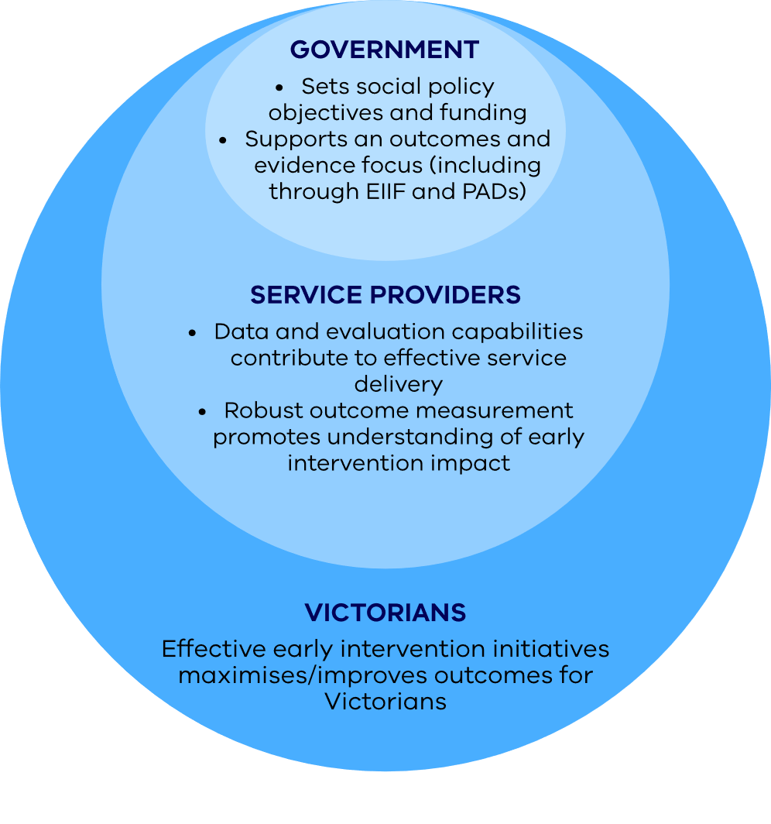
Building sector capability: Empowerment fund
The Empowerment Fund seeks to address barriers the social service sector faces relating to data and evaluation capability. Objectives of the Fund include:
providing data capability uplifts to ensure that data collection, information systems and storage are functional and are empowering organisations to better understand their service outcomes
better measuring the outcomes of early interventions and improving the accessibility of information
supporting program evaluations, including internal capabilities and tools to improve evaluation practices
sharing learnings so insights and a broader evidence base on ‘what works’ can be promulgated across the sector.

Slide 28
Lessons for implementing similar wellbeing approaches in other jurisdictions - toolkit
These four domains were:
Stakeholders external to government – ‘Building partnerships outside of Treasury’
Cultural shift within government departments – ‘Making EIIF easy and building trust’
Robust underlying economics and evidence – ‘Upholding integrity in estimation across initiatives’
  Financial incentives – ‘Deliver savings, manage risk and driving positive behaviour’

Slide 29
Domain 2: Making EIIF easy and building trust
Fostering cultural shift in government and preparing departments with the necessary skills to come on the journey
Treasury collaborating with departments on parts of EIIF budget proposals
Upskill departments in modelling
Treasury co-review models with departments and share decisions
Sharing of outcomes reporting as feedback loop with departments
Public sharing of information and learnings
Around 10 per cent of EIIF initiatives were modelled by departments in the 2021-22 Budget
VS
Nearly 50 per cent modelled by departments in the 2024-25 Budget
Building a culture of transparency and trust
Examples include:
Direct impacts published in budget papers
Client Pathway reports
EIIF framework paper
More available on the Department of Treasury and Finance website
Fostering culture of transparency and trust
Treasury chairs whole-of-government review process where departments may review and critic modelling approach and assumptions. Treasury acts as circuit breaker where agreements are not reached

Slide 30




It didn’t happen all at once – continuous improvements progressively led to greater transparency and trust
2021-22 Budget
2022-23 Budget
2023-24 Budget
2024-25 Budget
11
Initiatives
16
Initiatives
22
Initiatives
28
Initiatives
Set up outcomes reporting and financial incentives
Estimating avoided costs to the Victorian Government
Estimating broader economic benefits
Benefits and costs in budget papers

Slide 31
Treasury made ongoing collaboration efforts to strengthen the quality of new EIIF proposals
Treasury developed its in-house avoided cost model, and supported departments as an internal-to-government technical assistant for last 3 years/budgets
At the same time, investments in departments’ own analytics through EIIF have supported growth in capability
Building knowledge base: research partnerships with peak bodies, departments and academics; findings made available to all departments
Continued adherence to the EIIF methodology and to transparency has provided stakeholders constancy and progressively built greater trust in applying methodologies

Slide 32
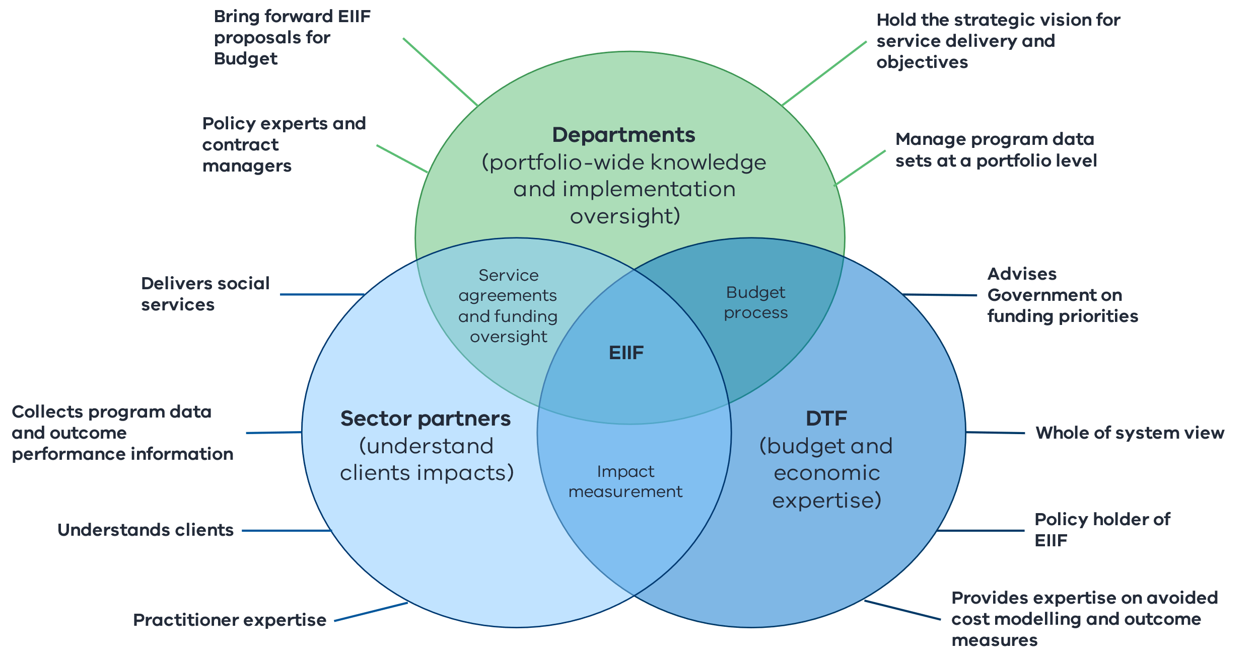
Collaboration underpins EIIF, it is core and it is necessary!!!
  Delivering the objectives of EIIF relies on strong collaboration between:
  Sector partners – who deliver services, understand clients, collect data on outcomes
  Service departments – hold policy expertise, contract managers, data custodians
  Central government – whole of system view, manage budget process, can incentivise greater early intervention and a greater focus on evidence.
Treasury

Slide 33



EIIF can support early intervention initiatives of varying scale and maturity
  Over time, initiatives with strong evidence of impact (“those that work”) now have a pathway for scale-up.
Where successful, expanded programs based on pilots have the potential to be scaled up through the EIIF. EIIF reporting also gives the opportunity to discontinue or redesign programs that don’t work as expected.
Pilots
EIIF
  Case study
  The Journey to Social Inclusion initiative started out as a small-scale pilot. By demonstrating evidence of impact, it was extended and finally scaled-up through EIIF funding in the budget having proven outcomes were replicable at larger scale.
Expanded program(s) based on pilots
Process to scale up initiatives
Proof of concept
Scale up
Established

Slide 34
Lessons for implementing similar wellbeing approaches in other jurisdictions - toolkit
These four domains were:
Stakeholders external to government – ‘Building partnerships outside of Treasury’
Cultural shift within government departments – ‘Making EIIF easy and building trust’
Robust underlying economics and evidence – ‘Upholding integrity in estimation across initiatives’
  Financial incentives – ‘Deliver savings, manage risk and driving positive behaviour’

Slide 35
Domain 3: upholding integrity in estimation across budget proposals
A need to focus on consistency and accuracy over political agenda
Consistent approach to quantification and prioritisation of budget proposal in decision making
    Advice on ranking of proposals grounded in evidence
Cross-review of modelling and assumptions
    Collaboration resolves most issues, Treasury acts as circuit breaker for impartial review
Design of outcomes reporting
    Treasury provides advice on effectiveness of programs before budget decision making each year

Slide 36
Treasury collaborates with departments to design outcome measures, and communicate client-focused stories
Departments have the autonomy to propose outcome measures that are feasible and fit-for-purpose within their EIIF budget proposals, and DTF openly collaborate on design of these measures before budget.
Measure relating to a system-wide service impact that underpins an avoided cost estimate
Treasury guideline highlights two key dimensions that should be included:
Measure that captures the service users’ experience and what they gain through the program
Treasury then access the outcome measures proposed based on whether they have:
Build evidence space where existing literature space is lacking
Benchmark against another program
Well defined measures
Provided baselines and targets
Supported by evidence
Other considerations for good outcome measures include whether they can help:

Slide 37
Outcomes reporting can start as early as immediately after Budget and informs upcoming Budget considerations
EIIF Annual Reports provides the Government with evidence on the impacts being achieved by funded programs. It can inform future investment decisions by offering a space to highlight initiatives with evidence of high impact or emerging evidence to help strengthen the case for further funding.
Information request to departments
July
Departments provide outcomes data to Treasury
July - October
Treasury collaborates with departments to refine draft report
October - November
Final Outcomes Report provided to Government before budget deliberations
December
Treasury uses report findings to inform advice on prioritisation of EIIF proposals in the upcoming budget and shares final report with all departments after providing to Ministers

Slide 38
Data plays a critical role in evidence-based decision making under EIIF
Treasury uses data in all phases of EIIF analysis and decision making. Below is a list of key data that Treasury currently has access to and is utilised as part of EIIF budget process:
Types of data | Data sources | How does Treasury access the data | How Treasury uses the data
Government linked data | Victorian linked data resource | Seek approval to access data through whole-of-government governance process | Avoided cost modelling Inform the setting of outcome measures and baselines
Program area data | Client surveys Data collected from implementation | Provided by departments as part of budget proposal collaboration and/or outcomes reporting processes Lapsing program evaluation | Avoided cost modelling Inform outcomes reporting Inform broader economic benefit calculations Assess evidence base for program effectiveness
Publicly available data | Population data Census Public evaluation reports | Online Research partnerships with the sector
What to do when data is unavailable
When data is not available, Treasury uses publicly available information or existing programs that are ‘best proxies’ and revise estimates when actual outcomes data are reported as part of the outcomes reporting. While not applied in our jurisdiction, if there was insufficient linked data available to drive detailed modelling, note that at one stage we considered multipliers to estimate program benefits (e.g. avoided costs) but noting we’d likely need to manage greater estimation risk via actuals tracking of outcomes if that approach had been taken. Less data or less collaboration inherently increases estimation risk, which will require ways to manage this risk as part of decision-making process and subsequent tracking/evaluation. As the size of scope of proposal increases, this also needs consideration in advice – for example, if limited information on program to begin with, then start with a small or existing services level and track further data over time to support potential scale-up opportunities.

Slide 39





Approach to calculating avoided costs
Avoided costs are the monetised value for Government of the expected reduction in future acute service expenditure from an early intervention, compared to business-as-usual.
Steps to estimating avoided costs
1. Define the proposed cohort(s) being targeted – scale and characteristics (including the nature and extent to which they use acute services)
2. Specify how the initiative works and how it will impact the cohort’s service use (i.e. the theory of change)
Avoided Costs for an EIIF initiative
Cost
Acute service use –
BAU trajectory
3. Estimate the reduction in acute service use (including initial and downstream services)
Estimated avoided costs
4. Estimate unit costs for affected services using departmental or public cost information
Acute service use –
EIIF trajectory
5. Estimate avoided costs by combining the change in acute service use with the unit costs for specified cohorts.
Time
Service delivery
commences

Slide 40
Estimating economic benefits
Benefits generated by
EIIF investment
EIIF impact quantification: how these benefits are captured
EIIF economic benefits: the following direct benefits can be estimated for each EIIF initiative
Avoided expenditure - Victorian Government
EIIF avoided costs
1. Avoided expenditure to the Commonwealth Governments: reductions in spending on MBS, PBS and welfare payments
Avoided expenditure - Commonwealth and local governments
2. Avoided expenses to individual/business: avoided medical expenses and victim costs associated with crime and family violence
EIIF economic benefits
Avoided expenditure - private
3. Individual gross earnings (incl tax): additional income from increased labour force participation (from entering employment or avoiding sick days)
Improved life outcomes - labour market participation
EIIF outcome measures
(may also capture all other
benefit types as well)
Benefits excluded from estimation include the value of a statistical life, worker productivity, macro variables (inflation, GSP, etc) and other indicators (happiness)
Improved life outcomes - other

Slide 41
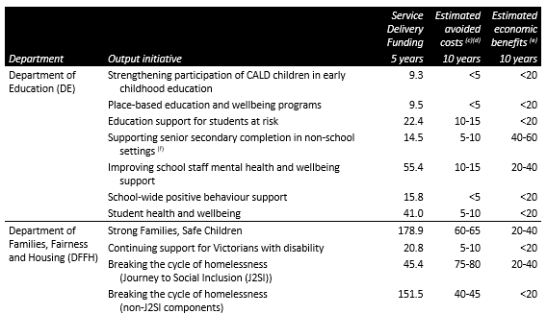
Benefits and costs for each EIIF initiatives presented in public budget papers
Outcomes tracking remains non-public
DTF works with Departments to track outcomes against agreed targets and baselines.
Descriptions/outputs for each initiative outlined publicly, but outcomes reporting remains non-public to ensure we maintain a dialogue on ‘what works’ (not just accountability).
DTF provides outcomes tracking advice to Government prior to budget each year.
Cost
Benefits
Service delivery funding announced in the budget
DTF tracks outcomes against benchmarks non-publicly to measure effectiveness of each program.
50 per cent of estimated avoided costs booked as savings acknowledging implementation risks and benefits-sharing between centre and line-agencies
DTF estimates economic benefits for each initiative based on their direct impacts (e.g. excludes macroeconomic impacts), and no savings apply for these estimates.

Slide 42
Lessons for implementing similar wellbeing approaches in other jurisdictions - toolkit
These four domains were:
Stakeholders external to government – ‘Building partnerships outside of Treasury’
Cultural shift within government departments – ‘Making EIIF easy and building trust’
Robust underlying economics and evidence – ‘Upholding integrity in estimation across initiatives’
  Financial incentives – ‘Deliver savings, manage risk and driving positive behaviour’

Slide 43
Domain 4: Setting the right incentives to manage risks and drive positive behaviour and more early intervention investment
 | Positive incentives for early intervention | Requirements and limitations to manage risks
Balancing fiscal sustainability | Departments retain 50 per cent of avoided costs when implementing initiatives (also acting a buffer for any estimation risk). For the other 50 per cent, this is returned to departments immediately in the subsequent budget as a reinvestment funding source for further early interventions. | An annual savings amount (dividend) is booked upfront to recover the other 50 per cent, but over 10 years rather than immediately with time given to begin implementing new initiatives before their application.
 | Reinvestment funding set aside for a department in the next budget is four times the savings it needs to absorb in the forward estimates. | Longer-term savings require departments to shift resources from acute to early intervention
Performance-related risks | Central government holds financial risks for underperformance. If outcomes reporting of actual data shows an initiative is not effective (e.g. not delivering 50%+ of its expect outcomes) then Treasury will reverse savings to departments – centre holds the risk. | After formal notification of an ineffective program, Treasury will seek cessation of the ineffective program, with funding returned to the centre or the program not re-funded.
 | If initiative is outperforming and generating higher outcomes and avoided costs, Treasury highlights the success in outcomes reporting to strengthen the case for further funding. Treasury does not increase booked savings for outperforming initiatives – Departments can fully harvest the additional upside benefits. If an initiative seeks further funding in future, new outcome measure targets and avoided cost estimates will be updated (higher/lower) for the most recent actual data reported.
Rewards for proactive fiscal discipline | No savings are applied for initiatives that are fully paid for by departments through departments’ proposed internal funding or reprioritised funds with the department. | If a department submits an insufficient number of high-impact new proposals to the budget, its reinvestment funding source can be moved to support higher-impact proposals in other departments

Slide 44
Translating annual savings and reinvestment funding from economic modelling
The annual savings are applied ongoing from year three. This ongoing application recognises Victoria’s financial systems are based on the next four years only (i.e. forward estimates), with booking ongoing ensuring savings are recouped in the longer term (i.e. taken off base funding).
No savings are applied in the first two years to allow programs to become established and generate impact
In the example to the right:
    $30m in estimated avoided costs from reduced future service usage to the department (over 10 years) across all EIIF initiatives
    $1.5 annual EIIF savings calculated as 50% of $30m avoided costs divided by 10 years, applied from year 3 (ongoing)
    $12m available for reinvestment in next year’s early intervention budget proposals plus benefit of retained 50% of avoided costs
ILLUSTRATIVE EXAMPLE:
Department EIIF savings and funding set aside for subsequent budget
 | 24-25 | 25-26 | 26-27 | 27-28 | 28-29 | 29-30 | 30-31 | 31-32 | 32-33 | 33-34 | 10yr total ($m)
Avoided cost estimates | 0 | 2 | 2 | 2 | 5 | 5 | 5 | 5 | 2 | 2 | 30
Annual dividends | 0 | 0 | 1.5 | 1.5 | 1.5 | 1.5 | 1.5 | 1.5 | 1.5 | 1.5 | 12
Available for reinvestment within department | $12m in reinvestment funding for future EIIF initiatives in future budget

Slide 45
Translating economic benefits to savings achieves fiscal sustainability over time
EIIF takes an invest/reinvest approach to help realise the benefits from economic impacts and manage risks:
Avoided cost estimates inform benefits accruable to each department
Departments retain half of the benefits accrued as buffer for estimation risks
50 per cent of the benefits are applied as annual savings to create capacity for future early intervention investment, which is usually reinvested back into the department in the following budget
EIIF needs to carefully manage positive and negative incentives to encourage departmental investments in early intervention.
ILLUSTRATIVE EXAMPLE ONLY
$80m budget funding for department A
$100m in estimated
avoided costs (across all departments)
Department A
Department D
Department B
Department C
$60M
$30M
$5M
$5M
Avoided costs
50 per cent of these avoided costs are then made available for the respective department to use in the next budget on EIIF initiatives

