Slide 1
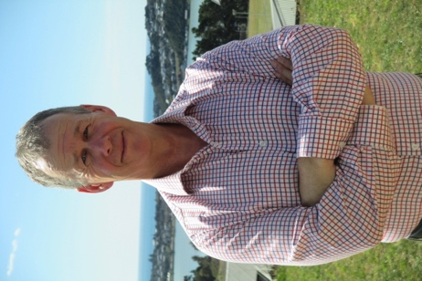
Kerry Boyle
Kerry.boyle@orcon.net.nz, M 00 (64) 21 509 132
ABOUT
QUALIFICATIONS
A specialist investment management consultant with experience developing business cases, strategies and feasibility studies for the public sector. A former business analyst, Kerry has worked with dozens of clients including local authorities, NGOs, universities, District Health Boards and central government agencies. Kerry is especially interested in all of government programmes and anything with an international component. He has been an active member of the NZ Institute of International Affairs since 2013.
Known for sharp insight and a down-to-earth workshop approach. Kerry ‘gets it’ quickly, and can help you to distil complex information into clear trends and key messages.
Master of Strategic Studies, Victoria University
Advanced Dip. Systems Analysis and Design, Auckland University of Tech.
Dip of Enviro. Studies, Open Polytechnic NZ
Post Grad Dip. Wildlife Mgt, Otago University
BSc Zoo and Psych, Otago University
INVESTMENT LOGIC MAPPING
Investment Logic Mapping (ILM) is a focused, strategic method that enables organisations to start with the end in mind. A series of facilitated workshops enables us to understand problems, outline benefits and generates an appropriate policy or investment response.
Developed by the Victorian Department of Treasury and Finance, ILM challenges organisations to make fit-for-purpose, evidence-based investment decisions and produces a simple, common-sense ‘map’ to demonstrate this logic. In New Zealand, ILM has been recommended by the NZ Treasury since 2005. ILM integrates neatly with the Better Business Case model, underpinning the Strategic Case. It is also used as an early scoping or ‘fast fail’ technique to decide whether to move to business case stage, as a Gateway checkpoint or test, and as an investment evaluation technique.
The ILM method leverages the collective knowledge of a carefully selected group, using informed discussion to deeply understand the context of an investment. A skilled facilitator will guide the session, testing assumptions and asking a series of questions. Facilitators should be independent of the investment, unbiased and willing to challenge.
For further information about ILM check out the DTF and NZ Treasury websites.
ACCREDITATIONS
Investment Logic Mapping (ILM) Facilitator
Better Business Cases (BBC)
Managing Benefits
Certified Process Professional
Arbiration of International Disputes
Strategic Management/Formulation/Implementation
https://www.linkedin.com/in/kerry-boyle-6b87aa3/
WHY CHOOSE KERRY?
WORKSHOPS AND COSTS
Knowledge – DTF accreditation complements extensive facilitation, policy and strategy experience.
Skill – Kerry pulls themes and issues apart and ensures participants see the ‘story’ take shape in their own words.
Challenge – Not afraid to ask tricky questions, Kerry brings sharp insight to your investment challenges.
The Department of Treasury and Finance (DTF) recommends up to four
two-hour ILM workshops to define problems, outline benefits and design a strategic response.
Kerry will tailor the number of workshops required depending on the size and scale of the investment, and integrate ILM work with other processes such as Better Business Cases (BBC). Each workshop costs $3000 + GST.
An additional Risk workshop can also be run that explores the risk to Benefits that will form the basis for Benefits-Risk report framework to Governance.
Wellington-based and regularly travels across New Zealand at cost.
✉kerry.boyle@orcon.net.nz ☏ 00 64 (0) 21 509 132

