Slide 1
Investment Management 2017
Facilitator Forum
Overview and changes to the IMS and facilitation practice
Notes:
I acknowledge the Traditional Owners of the land on which we are meeting. I pay my respects to their Elders, past and present, and the Elders from other communities who may be here today.

Slide 2
Agenda
Context for the IMS review and update
Findings from initial consultation and review
Summary of changes
Changes to current practice:
  preparation and evidence
  uncertainty and real options analysis
  problem trajectory: unpacking cause and effect
  benefit: measures, baselines and targets
  response: options shaping, KPI alignment, generating report
  solution: cost and timeframe, shaping solution
Accreditation
Questions
Notes:
DTF (Joe) to outline the organisational / Government context for the IMS review and confirm DTF’s support for the policy framework
Rae Fankhauser to present the technical detail of the changes being introduced in this IMS update
Eldar Salkovic, Innox Solutions, introducing himself as the recently-appointed IMS accreditation provider and outlining his services.
Q&A throughout presentation and at end.
There will also be time at the end for networking

Slide 3
Context
The 2017 IMS update is the first major policy review of the IMS in five years.
Substantial interest from departmental users to retain the framework’s currency
The update is needed to:
  address feedback and known limitations with existing processes
  raise practice and output quality to meet increasing expectations
  align the IMS with broader Government policies and priorities
  formally recognise the importance of dealing with uncertainty when developing investments, and emerging and increasingly important Government policy requirement.
Notes:
The IMS has not been significantly reviewed and updated in over 5 years.
A refresh is needed to
Address known policy and process issues:
Some elements of the IMS have been in use since 2005, and have benefitted from a number of iterative reviews and refinements. Other elements, particularly the third Response Workshop (previously the Strategic Options workshop), were introduced in the last major policy update and have not been refined over time. There are some known issues and limitations with the previous IMS edition that required improvement.
Raise quality of outputs to meet increasing expectations
In the five years since the last IMS update, departments have improved their investment management capabilities and are better able to meet requirements. This has driven an increase in expectations from Government and central agencies regarding the quality of outputs (e.g. better benefits definition, better options analysis)
Align the IMS with broader Government policies and priorities
Although the IMS has not received a significant update in the last 5 years, other areas of infrastructure delivery policy and practice have seen significant change, including the emergence of a range of issues that influence investments at the initiation and development stage. EG. The Asset Management and Accountability Framework and the Victorian Government’s Value Creation and Capture Framework.
The most significant policy development in infrastructure delivery is Government’s interest in more effectively dealing with uncertainty.

Slide 4
Findings
Overarching comments were positive and indicated that IMS is generally working well and is seen as a key mechanism to aid investment decision-making and business case development
Why make changes?
'a flawed ILM (IMS) process can result in a deeply flawed business case (noting several tens if not hundreds of thousands of dollars could be expended on a poorly developed business case that is unlikely to be supported or if supported unlikely to delivery the intended benefits)'
In principle IMS deals with the concept of managing uncertainty but from a government/DTF perspective this needs to be strengthened for major infrastructure investments with long lifecycles, high cost and high complexity. real options analysis.
Detailed real options analysis is outside the scope of IMS workshops and belongs in business case development and shaping of project options. However IMS can/should be a trigger for real options analysis where significant uncertainty is identified.
Notes:
3

Slide 5
Findings
Improvement opportunities
Provide more direct instruction/training for departments regarding the rigor, preparation and expectations and scheduling of IMS workshops and the role and expectations of participants.
Reinforce relationship between the IMS documents and the business case and maintaining currency and alignment between these documents.
Improve problem identification and precision. Too often the focus is on a symptom rather than root cause. Problems also fail to tell an evidence based story of the effect…that is a measurable end consequence. A stronger logic flow throughout the maps is required to align Problem and Benefit with the Response and Solution.
Evidence supporting Benefit Definition is often weak and the relationship between Problem and Benefits and KPIs needs strengthening.
Strategic Response workshop is under huge time pressures that can compromise the outcome. The focus should initially be on shaping genuine strategic options that demonstrate consideration of demand, productivity and supply levers. The alignment between interventions, grouping and KPIs is not sufficiently transparent.
Solution workshop often fails to demonstrate real value – Investor doesn’t turn up. Need to emphasise that this is an indicative solution and subject to amendment with further analysis.
Notes:
4

Slide 6
What remains the same in IMS 2017
Key principles of IMS:
  informed
  evidence based
  decisive
  focused
  immediate
  clear
  facilitated
Logic flow across the ILM and the case for investment is robust, clear and easy to understand
Primary purposes:
  investment filtering
  initial decision to proceed to full business case
  assist in business case development
  ongoing reference for
  in-flight projects
Four workshops of two hours duration
Investor plus up to seven others who are the best thinkers and know the most
Notes:
Informed – they require the investor (the person who has the business problem and will be responsible for achieving the benefits) and those with the most knowledge of the operating environment, the strategic priorities of the organisation, and its stakeholders to participate;
Evidence-based – each statement in the investment story must be supported by evidence. Typically, this evidence is already available and simply needs to be gathered in advance and applied in the workshops to build a robust case;
Decisive - the practices are structured to address a sequence of decisions that are fundamental to the potential investment. It is not possible to move along the IMS ‘line of enquiry’ without substantively concluding the previous stage;
Focused – each discussion is no longer than two hours. This has been found to be short enough period to obtain the time commitment of senior people, and a long enough period to extract, and agree, an investment story;
Immediate – the workshop outputs are concluded within 48 hours of the workshop. During this period the decisions made are circulated and any outstanding matters are discussed and resolved using electronic channels;
Clear – the story of the investment is told in plain English and using concepts that can be understood by a lay person; and
Facilitated – an independent facilitator is responsible for providing appropriate advice in respect of workshop preparation, evidence requirements, process, and participants; extracting and telling the investment story in a way that will maximise its value to the organisation; and generating the workshop outputs in approved templates.

Slide 7
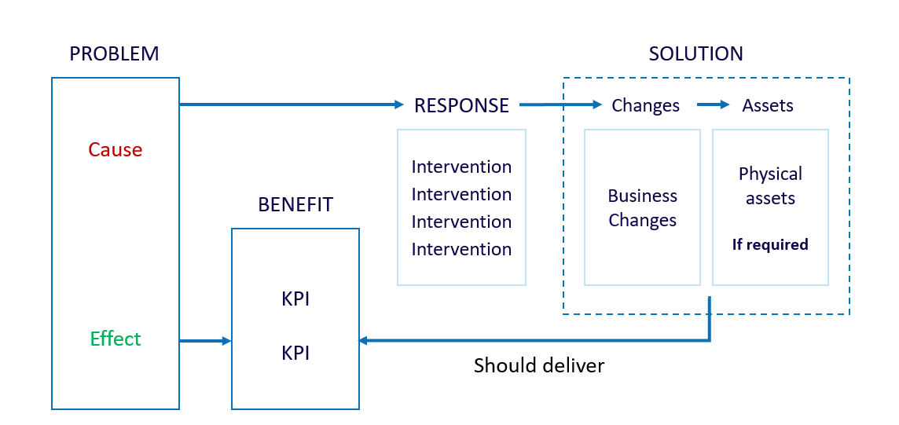
Logic flow of an investment story is robust and transparent

Slide 8
What’s different in IMS 2017
Major changes
Preparation is required before each workshop
Uncertainty must be considered and where relevant recorded as part of the products from each workshop. Recommendation for Real Options Analysis is made in the Response and Solution workshops.
Problems must be unpacked in a methodical and structured manner and a record circulated to the participants.
Response workshop has been reshaped to support better, discrete options development, closer alignment between intervention and KPIs, and targeted assessment.
Solution Definition workshop reports cost and timeframe for all options and confirms ranking prior to detailing the specific solution of the preferred option.

Slide 9
What’s different in IMS 2017
Minor changes
Amendment to the ’16 Questions’ to incorporate consideration of uncertainty.
Clearer specification of attendees and rationale for varying participants.
Clearer expectations for department about preparation, participants, timing and number of workshops.
Removal of 'strategic' from Response and Interventions labels.
Minor changes to templates to address uncertainty and improve usability.

Slide 10
Practice change
Preparation and evidence is required prior to each workshop
Each workshop in the IMS suite has a specific focus and evidence is required to support the discussion in each workshop. Facilitators should advise department clients about the need for evidence and type of evidence required.
A core of approximately 60 per cent of participants in the Problem Definition workshop will continue throughout all workshops. Other participants will be invited based on expertise and expected contribution at specific workshops.
Early engagement with the Investor is vital and ideally occurs at least 2-3 weeks prior to the first workshop
Notes:
9
Each workshop in the IMS suite has a specific focus and preparation is required for each workshop
Problem Definition
Participants should bring a depth of understanding about the issues and be very familiar with any existing relevant materials such as: briefing papers, background reports, external reviews, internal management reports etc. They should be able to refer authoritatively to this evidence during the workshop.
Benefit Definition
It is critical that the investor, participants (and the organisation) present with an explicit understanding of the wider environmental drivers, the organisation’s strategic intent and any significant internal or external performance targets and timeframes that they must achieve.
Evidence will need to be substantiated during this workshop and will usually need to cover both the external and internal operating environments. If evidence is weak, you may need to spend more time and effort to understand the current or projected state.
The indicative KPIs identified in the Problem Definition workshop should be reviewed prior to the benefit workshop to determine whether these KPIs are meaningful, measurable, and primarily attributable to the investment. This will provide a good starting point for the workshop which, otherwise, may lack focus.
Each workshop in the IMS suite has a specific focus and preparation is required for each workshop
Response Definition
This workshop will not succeed unless there is a clear and common understanding and agreement about the problems, benefits and KPIs. KPIs specified in the Benefit Map should be confirmed and are as developed as possible with baselines determined and indicative targets set.
Participants should review the list of potential interventions provided by the facilitator and generated by the conversation in the previous workshop. They should begin to think about overall responses from the least complex (do minimum) to the most complex and far-reaching as well as demand, productivity and supply based interventions.
Some participants should have experience with shaping and implementation of a variety of options
Solution Definition
Prior to this workshop, it is vital that the investor’s nominee compiles and circulates cost and timeframe data for each of the response options is compiled and circulated to the facilitator and all workshop participants. Costs and timeframes can still be ‘best estimates’, but some rigour should have been applied to both in the period since the Response Definition workshop.
Ideally a ‘best likely’ solution that describes the preferred response option is prepared, together with the rationale for its selection and the set of change and assets needed for implementation. This preferred option may alter once the project team assesses the cost and timeframe data, is assessed and the solution will need to be redefined.

Slide 11
Practice change
Consideration of uncertainty and real options analysis
There is an increased focus on improving the planning and delivery of infrastructure investments, and on using real options analysis to manage related uncertainty.
Uncertainty, its sources and its potential impact on benefit delivery, option selection and solution design is considered in all workshops and where relevant this is recorded in IMS documents.
The role of the IMS is to identify uncertainty and its impacts on an investment and, where those impacts are potentially significant, recommend further investigation, Real options analysis is outside the scope of the IMS.
DTF is updating its Investment Lifecycle Guidance to provide advice on incorporating real options analysis when developing business cases and procurement strategies for significant asset related investments
Notes:
10

Slide 12
Risk and uncertainty
Risk is a variance (either positive or negative) from an expected outcome.
Risks usually apply to the delivery of a project.
They are inside the project team’s control to minimise and mitigate to achieve the defined scope and expected benefits.
The Response Definition and Solution Definition workshops identify the key risks related to achieving an investment’s benefits, for further analysis in the business case.
Uncertainty is an event or change in conditions.
Uncertainties usually relate to the problem or investment need.
They are usually external factors outside the project team’s control.
They can result in a different future state to that anticipated or assumed in the business, and can impact the need for an investment and can require a change in response.
These events include technological developments, major shifts in markets and economic conditions, the behaviour of other organisations, demographic and societal structures, or the natural environment. If such events occur they can have both positive and negative impacts on benefit delivery.

Slide 13
Real options analysis
Real options analysis is an investment evaluation and decision-making framework which introduces more flexibility to the management of infrastructure projects that are significantly affected by uncertainty.
It assists Government make investments that are more adaptable over time and better able to meet the community’s evolving needs
May be recommended when primarily asset investments are significant, high cost and complexity and have a medium–long lifecycle

Slide 14
Practice change
DTF requires participants to consider uncertainty during each IMS workshop. Participants should consider how their investment may be impacted by uncertainty, and how the preferred response might change if assumptions don’t hold or future conditions do not unfold as expected.
Requirement 1: If uncertainty is identified during any workshop, this should be captured within the workshop outputs, and must be considered, tested and addressed in the business case (if the proposal proceeds to that stage).
Requirement 2: If the uncertainty identified is significant, and the proposal is asset-related, DTF expects departments to undertake real options analysis to inform business case development.
If participants do not identify significant uncertainty during the four IMS workshops, and real options analysis is not considered warranted, the group must undertake a feedback loop at the end of the fourth workshop.
Requirement 3: At the end of the Solution Definition workshop, review the decision-maker’s Checklist and test:
Has the investment need been correctly defined – are we considering the right problem?
Under what conditions would the preferred solution be a sub-optimal response?
Under what conditions would an alternative investment strategy be preferred?
Under what conditions would we regret this investment?
Notes:
DTF has made this framework change to recognise the critical influence uncertainty can have on investment success. DTF also recognises that the IMS, as a stand-alone product, explicitly and by design does not adequately address significant uncertainty. The preferred option and alternatives identified in the solution definition workshop assume an expected future state, and it would be difficult to explore alternative investment trajectories and real options within the set of IMS process. If significant uncertainty is identified, a different set of tools is needed to inform investment options.

Slide 15
Timing of real options analysis
Real options analysis should be undertaken as early in the investment lifecycle as possible, either prior to of as part of the full business case.
In some instances the first workshop may identify that the investment need is subject to uncertainty to such an extent that real options analysis could help define the problem and benefits. In other instances, there could be value in going through the first three workshops, and using the outputs to inform real options analysis.
Real options analysis of an investment should document:
  The investment need, including how demand might change in response to an event or altered conditions
  The expected benefits, and how these might change given different future states
  Response options, and including responses to alternative investment trajectories and future states
  The preferred solution(s), including assessing under what conditions this solution would be sub-optimal, an alternative approach would be preferred, and/or the investment would be regretted.
  Where real options analysis is undertaken, this should be used to inform the business case and would supersede the IMS outputs (or the IMS outputs should be updated).
Notes:
DTF has made this framework change to recognise the critical influence uncertainty can have on investment success. DTF also recognises that the IMS, as a stand-alone product, explicitly and by design does not adequately address significant uncertainty. The preferred option and alternatives identified in the solution definition workshop assume an expected future state, and it would be difficult to explore alternative investment trajectories and real options within the set of IMS process. If significant uncertainty is identified, a different set of tools is needed to inform investment options.
Information about real options analysis and associated tools is contained in DTF’s 'Investing under uncertainty' technical supplement to the Investment Lifecycle Guidelines.
Each workshop in the IMS suite has a specific focus and preparation is required for each workshop
Problem Definition
An assessment of how uncertainty of different future scenarios may impact the way the problem is defined is an important element of this workshop.
Consider the organisation’s operating environment and the expected future state where this problem exists.
Where participants identify significant uncertainty about how the future may turn out, you should consider and record its potential impacts on investment success.
This will typically be captured in the cause and effect analysis diagrams from the whiteboard.
Benefit Definition
An assessment of how uncertainty of different future scenarios may impact the way the benefits are defined or realised is an important element of this workshop.
Consider whether the realisation of any of the proposed benefits may be materially affected by uncertainty.
Where participants identify significant uncertainty about how the future may turn out, you should consider and record its potential impacts on investment success.
This will be captured in the Benefit Management Plan (BMP) - Benefit Profile.
Response Definition
This workshop will not succeed unless there is a clear and common understanding and agreement about the problems, benefits and KPIs. KPIs specified in the Benefit Map should be confirmed and are as developed as possible with baselines determined and indicative targets set.
Participants should review the list of potential interventions provided by the facilitator and generated by the conversation in the previous workshop. They should begin to think about overall responses from the least complex (do minimum) to the most complex and far-reaching as well as demand, productivity and supply based interventions.
Some participants should have experience with shaping and implementation of a variety of options
Solution Definition
Prior to this workshop, it is vital that the investor’s nominee compiles and circulates cost and timeframe data for each of the response options is compiled and circulated to the facilitator and all workshop participants. Costs and timeframes can still be ‘best estimates’, but some rigour should have been applied to both in the period since the Response Definition workshop.
Ideally a ‘best likely’ solution that describes the preferred response option is prepared, together with the rationale for its selection and the set of change and assets needed for implementation. This preferred option may alter once the project team assesses the cost and timeframe data, is assessed and the solution will need to be redefined.

Slide 16
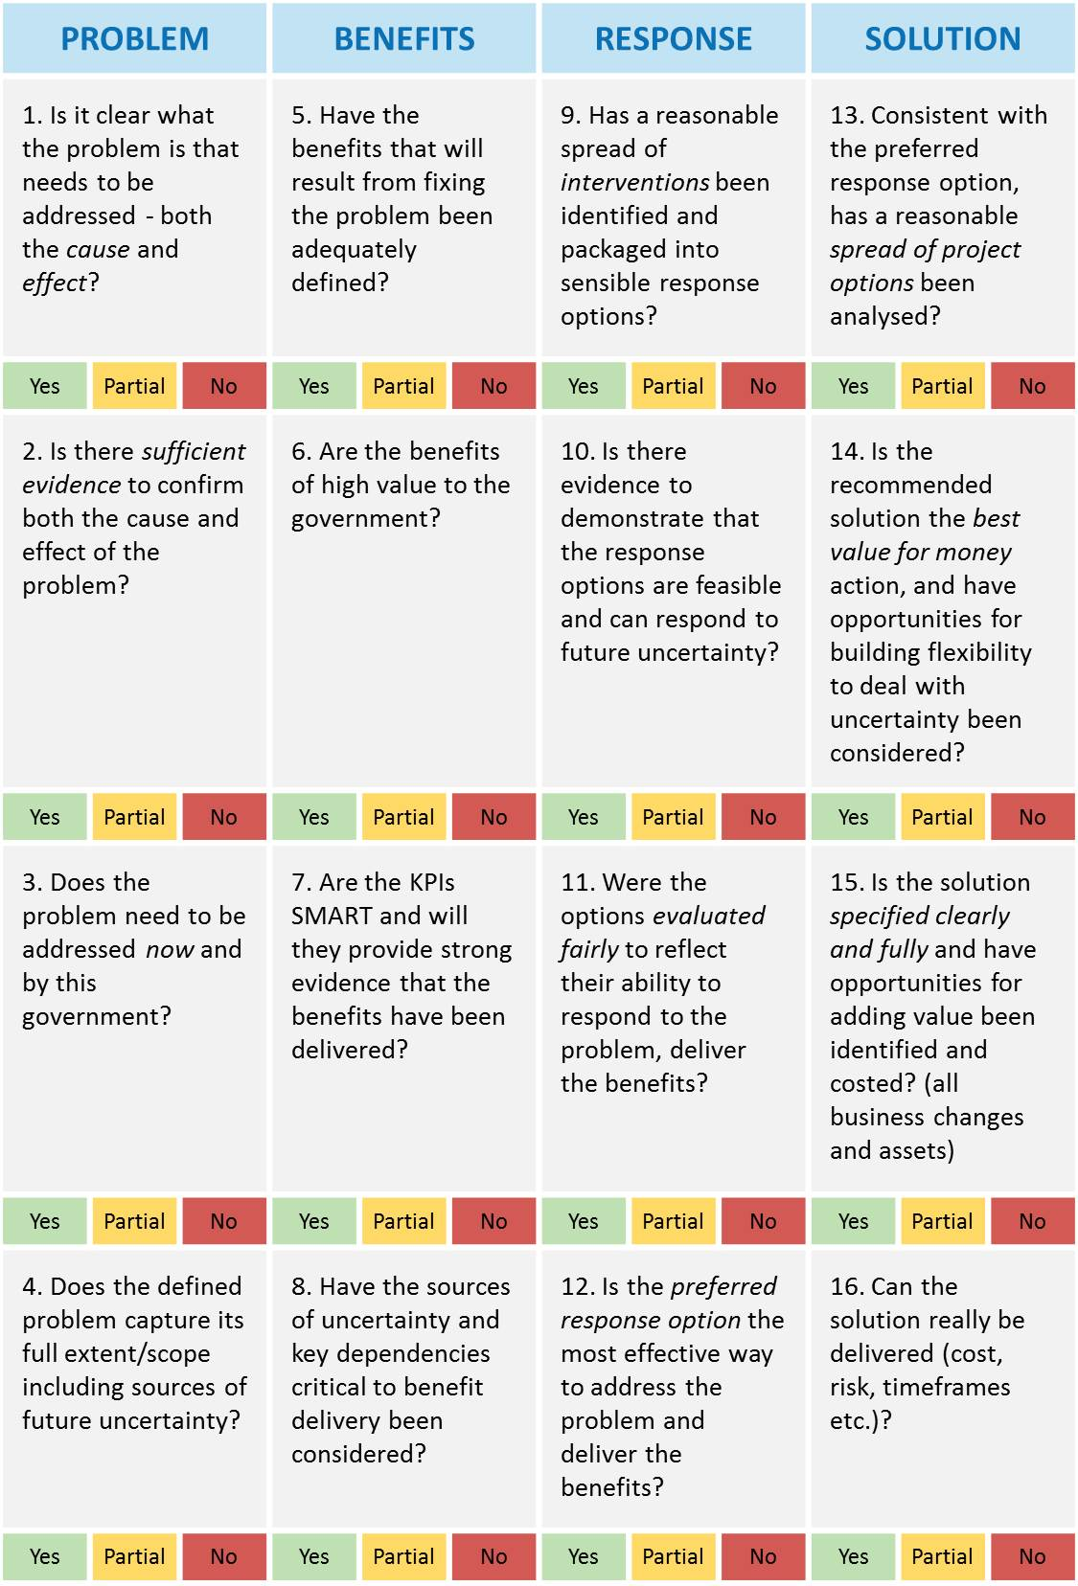
16 Questions Investment
decision-makers’ checklist

Slide 17
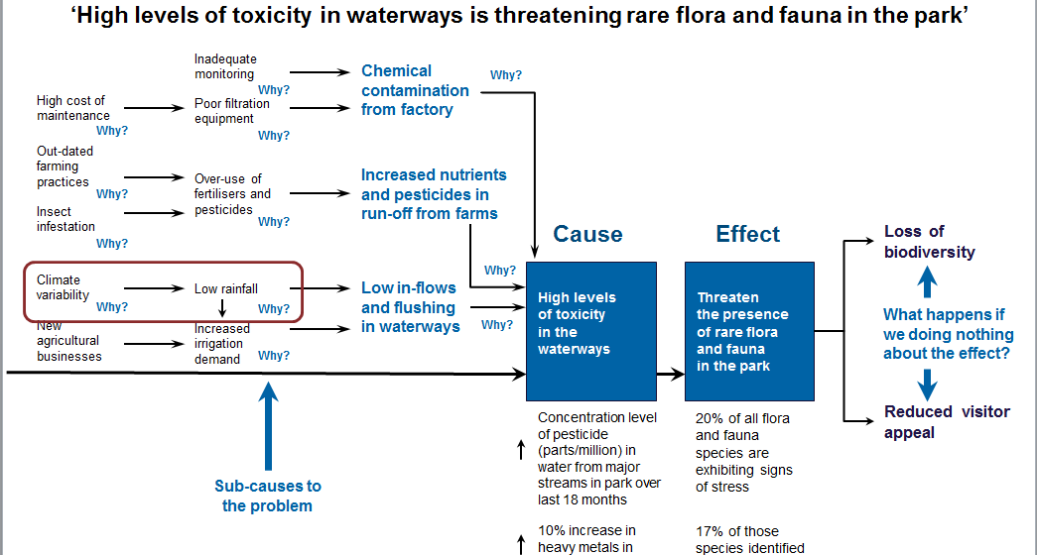
Considering uncertainty in IMS workshops
Problem definition
Consider the organisation’s operating environment and the expected future state where this problem exists.
Where participants identify significant uncertainty about how the future may turn out, you should consider and record its potential impacts on investment success.
This will typically be captured in the cause and effect analysis diagrams from the whiteboard.
Benefit definition
Consider whether the realisation of any of the proposed benefits may be materially affected by uncertainty.
Where participants identify significant uncertainty about how the future may turn out, you should consider and record its potential impacts on investment success.
Uncertainty
Unforeseen changes in economic conditions (whether favourable or adverse) have the greatest potential to affect the nature and timing of benefit delivery, and the achievement of targets. Most critical are the rate of growth of local emerging industries, and levels of overseas demand for agricultural commodities. A real options workshop will be undertaken as part of business case development to ensure that the investment is sufficiently flexible to respond to such changes.
Interdependencies
Benefit delivery assumes no material changes in State and Federal policies in respect of economic development and regional transport infrastructure. This Benefit Map also assumes that overall project delivery is on time (commencing 7/2018) and within budget, and that there is no material changes to scope.
Notes:
Problem definition
Key questions:
What is the cause and what is the effect or consequence and do we have evidence? How do we know?
What contributing factors and failures have contributed to this cause or breakage or failure i.e. why has this happened?
Has anything in the external environment changed or is likely to change?
Are there organisational causes, human causes, or physical causes?
Who and what is affected?
What external factors could impact on the cause or effect of the problem causing uncertainty?
Is the organisation operating in an environment of significant uncertainty and do the problem statements reflect this?
What will happen if we do act and circumstances change?
Are there any circumstances that may lead us to regret investing in a response to this problem?
Benefit Definition
Is achievement of any of the benefits, KPIs or measures, contingent on significant interdependencies?
Is uncertainty likely to materially impact any of the proposed benefits?
Would the need for a benefit, or your ability to achieve that benefit, be materially different in different future scenarios? Is achievement of any of the benefits, KPIs or measures, contingent on significant interdependencies?

Slide 18
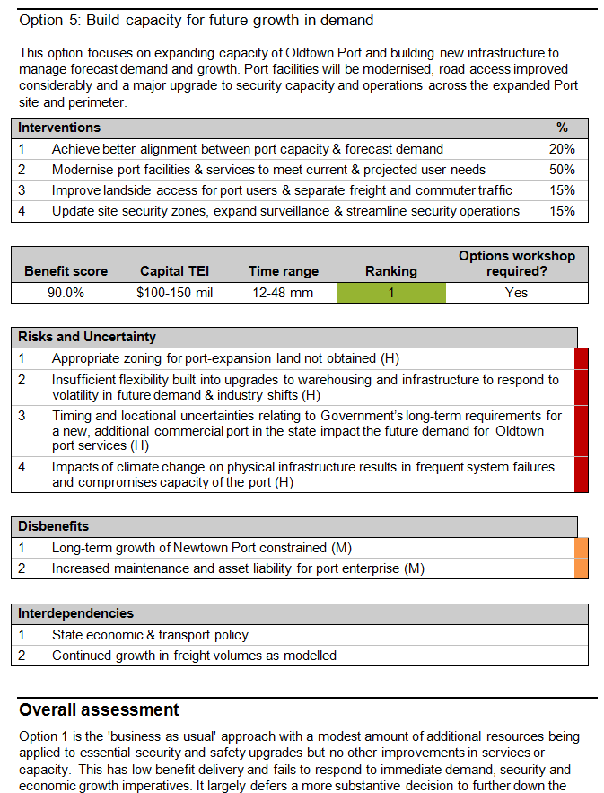
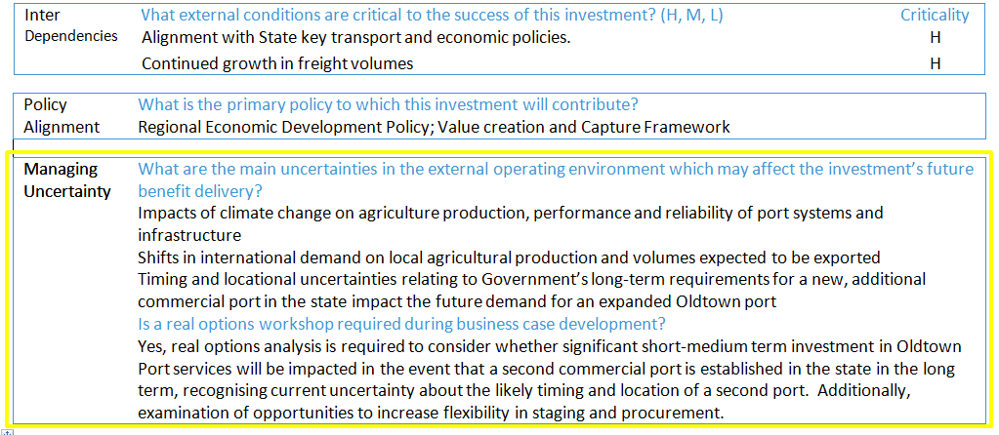
Considering uncertainty in IMS workshops
Response definition
A deliberate assessment of how effectively each response option deals with uncertainty is an important element of this workshop.
Consider what circumstances would lead to the preferred response being ineffective or inappropriate, and where a different response would be preferable.
Solution definition
A deliberate assessment of how effectively the solution deals with uncertainty is an important element of this workshop.
Consider the operating environment and supply markets and what circumstances would lead to the recommended solution being ineffective or inappropriate, and where a different response would be preferable.
Notes:
Response definition
Key Questions:
Are there are any other potential shifts in the organisation’s current or future operating environment, such as those arising from demographic, economic, environmental, social, political, industry or technological factors, which, if they occurred would fundamentally change the investment’s benefit delivery?
Would any of the response options become unfeasible if circumstances changed? Are there any circumstances or scenarios in which any of the proposed response would be less successful in delivering the planned benefits or would lead to investment regret?
What are the triggers for changing the response? Are any of the interventions contingent on material interdependencies?
Will this affect the need for, or approach to, the investment?
Do any of the proposed responses enable Government to respond flexibly to changing circumstances, minimising Government’s obligations under unfavourable conditions or enabling opportunities for benefit enhancement to be
Solution definition
Are there any external conditions or uncertainties that would lead to the preferred solution being inadequate or inappropriate, and where we might regret the investment approach?
Are there are any circumstances or future scenarios in which the preferred solution would be less successful in delivering the planned benefits or would lead to investment regret
Are there any external conditions or uncertainties that could where it is not possible to estimate the impact on the deliverability of the recommended solution?
What are the triggers for a change in response?
Does the recommended solution need the flexibility to respond to uncertainty?
Does the preferred solution enable Government to respond flexibly to changing circumstances, minimising Government’s obligations under unfavourable conditions or enabling opportunities for benefit enhancement to be leveraged.

Slide 19
Problem definition workshop
Problem identification
More robust and evidence based identification and substantiation of the problem is required.
Cause or what’s broken must be understood and supported by evidence and contributors to that breakage more fully unpacked and documented
Effect must be evidence based and give insight into the measurable difference that doing something about the effect will make
The relationship between cause and effect must be substantiated
The output of the whiteboard discussion should be captured and circulated
Structured methods for unpacking the problem include root cause analysis, decision tree analysis and problem trajectory
Notes:
18

Slide 20
Shaping good problem statements
Good problem statements
Correctly constructed with the CAUSE and EFFECT Supported by evidence that the problem exists and that there is a correlation between the CAUSE and EFFECT the EFFECT is an end consequence that is measurable NOT an intermediate outcome which is less compelling Is compelling and is something that we care about
'from reviewing some 400 hundred business cases over 10 years (development, filtering and budget bids) I believe more than 80% are constructed from defining the solution first. This effectively makes the ILM process redundant and nothing more than ticking a box function'
If asset failure is identified as the sole cause in a Problem statement it drives an asset-led response
too early.
Notes:
19

Slide 21
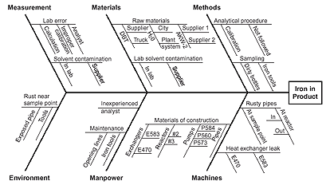
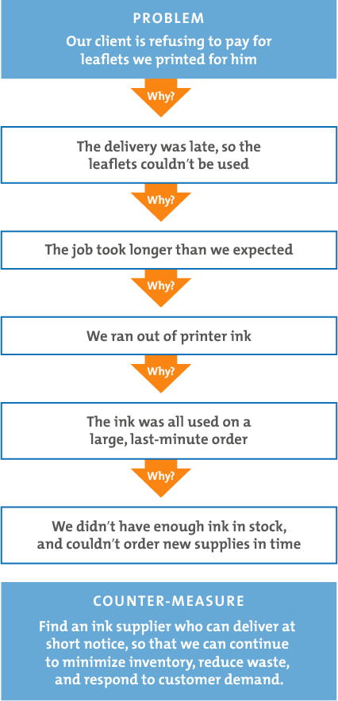
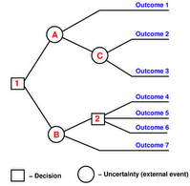
Tools for unpacking the problem
Ishikawa Root Cause Analysis
Decision-tree analysis
5 whys
Problem trajectory
Excerpted from Nancy R. Tague’s The Quality Toolbox, Second Edition, ASQ Quality Press, 2005, pages 247–249.
http://www.toolkitforthinking.com/problem-solving/decision-tree
https://www.mindtools.com/pages/article/newTMC_5W.htm

Slide 22
Problem trajectory – a structured approach
Inadequate monitoring
Chemical contamination from factory
Why?
Why?
High cost of maintenance
Poor filtration equipment
Why?
Why?
Out-dated
farming
practices
Over-use of
fertilisers and pesticides
Increased nutrients and pesticides in run-off from farms
Why?
Insect
infestation
Why?
Cause
Effect
Loss of biodiversity
Why?
Climate
variability
Low in-flows
and flushing in waterways
Why?
High levels
of toxicity
in the
waterways
Threaten
the presence
of rare flora
and fauna
in the park
Low rainfall
Why?
Why?
What happens if we doing nothing about the effect?
New
agricultural
businesses
Increased
irrigation
demand
Why?
Why?
Concentration level of pesticide (parts/million) in water from major streams in park over last 18 months
20% of all flora and fauna species are exhibiting signs of stress
Reduced visitor appeal
Sources of
uncertainty
Sub-causes to the problem
10% increase in heavy metals in waterways
17% of those species identified as under stress classified as rare
Evidence that the effect exists and can be measured
Evidence that the cause of the problem exists
25% reduction in stream flow and projected to continue
Risk to flora and fauna is rated medium to high

Slide 23
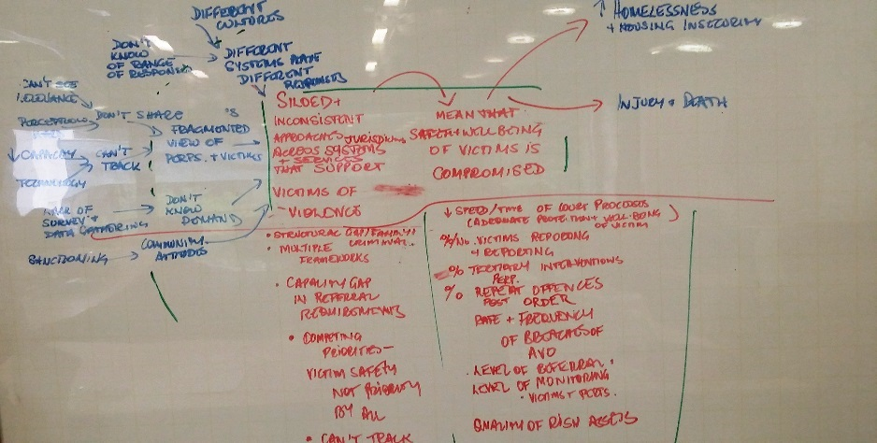
Unpacking the problems
Key questions here are:
What is the issue that we wish to unpack?
What is the prime cause/s that has resulted in this issue occurring?
How do we know? Look for evidence to inform the scale and scope of the cause:
  trends and rates of change- who is affected, when, and where
  temporal data – day of the week, different weeks or months (seasonal) or annual
  spatial patterns- different effects in different places or settings
  demographic data – who is affected, socio-economic factors
  internal and external performance data
  studies, research, reports – local and comparable international data
Why has this happened? What’s caused that?... and then what has caused that?
When this investigation reaches a natural conclusion focus on the effect of this issue
What is the prime effect that occur as a result of this cause? There should be a one to one relationship.
Focus on the direct and incremental relationships here to get real clarity around the problem. Look for evidence of these relationships.
What evidence is there that demonstrates the scope and intensity of this effect or consequence?
Exploring the causal elements/factors and then the effect and testing the evidence reveals the key relationships.
Notes:
22

Slide 24
Sequence for developing the problem trajectory
3
Inadequate monitoring
Chemical contamination from factory
High cost of maintenance
Poor filtration equipment
Out-dated
farming
practices
Over-use of
fertilisers and pesticides
Increased nutrients and pesticides in run-off from farms
Problem statement
6
1
4
Insect
infestation
Benefits
Improved Biodiversity
Climate
variability
Low rainfall
Low in-flows
and flushing in waterways
High levels
of toxicity
in the
waterways
Threaten
the presence
of rare flora
and fauna
in the park
New
agricultural
businesses
Increased
irrigation
demand
Improved visitor appeal
Concentration level of pesticide (parts/million) in water from major streams in park over last 18 months
20% of all flora and fauna species are exhibiting signs of stress
2
10% increase in heavy metals in waterways
17% of those species identified as under stress classified as rare
5
25% reduction in stream flow and projected to continue
Risk to flora and fauna is rated medium to high

Slide 25
Unpacking the problem helps to inform all elements of the ILM
Inadequate monitoring
Chemical contamination from factory
High cost of maintenance
Poor filtration equipment
Out-dated
farming
practices
Over-use of
fertilisers and pesticides
Increased nutrients and pesticides in run-off from farms
Problem statement
Insect
infestation
Benefits
Improved Biodiversity
Climate
variability
Low rainfall
Low in-flows
and flushing in waterways
High levels
of toxicity
in the
waterways
Threaten
the presence
of rare flora
and fauna
in the park
If we do something about the effect
New
agricultural
businesses
Increased
irrigation
demand
Improved visitor appeal
Concentration level of pesticide (parts/million) in water from major streams in park over last 18 months
20% of all flora and fauna species are exhibiting signs of stress
10% increase in heavy metals in waterways
17% of those species identified as under stress classified as rare
Potential KPIs and measures
Potential changes
and assets and
sources of uncertainty
Potential interventions
25% reduction in stream flow and projected to continue
Risk to flora and fauna is rated medium to high

Slide 26
Benefit definition workshop
Outcomes focused KPIs must have a clear relationship with the evidence that supports the Effect part of the problem statement.
KPIs must be measurable and lead to an action. We should need to do something differently to deliver this outcome.
Evidence around current or forecast state must be available for discussion at this workshop. This is the baseline.
Initial view of Target state should also be determined at least for the most important KPIs. This combination ensures that the KPI, measure and its target is SMART (Specific, Measurable, Attainable, Relevant, and Time-Bound
Uncertainty around benefit delivery should be recorded in the Benefit Management Plan
Benefits and KPIs communicate the measurable value of this investment to people, government, business, wider community. They must be outcomes that are of real interest to these groups.
Notes:
25

Slide 27
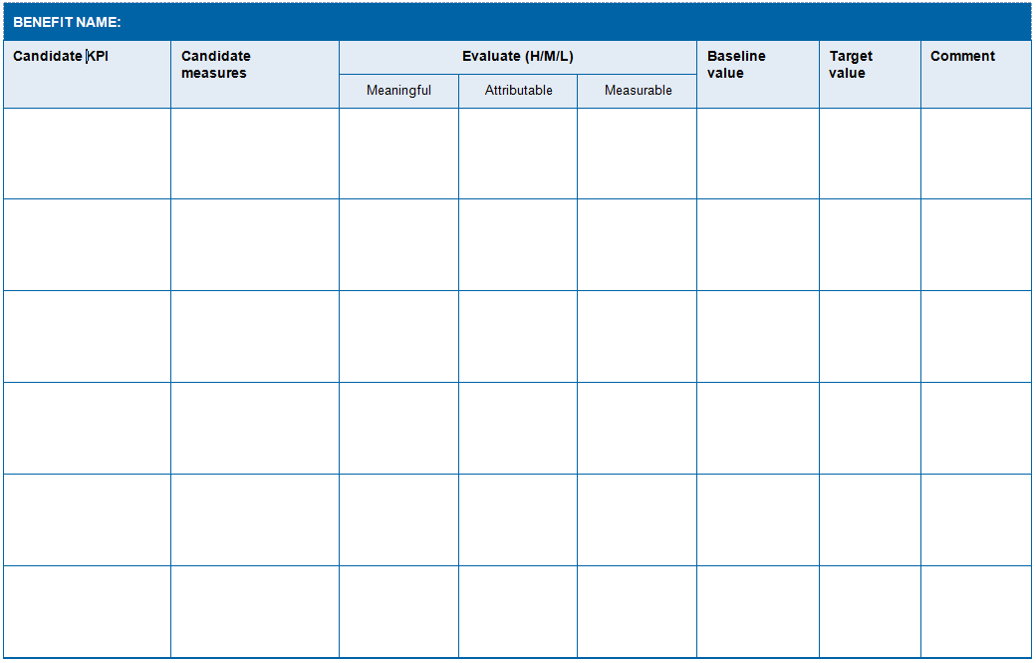
KPI input sheet

Slide 28
Response definition workshop
Response options analysis
Focus on shaping genuine options and then assessing them against criteria of benefit delivery, risk and uncertainties, disbenefits, critical interdependencies. This is the initial view of ‘value/public good’ that will be delivered by this investment. The estimation of cost and time in the Solution workshop will determine ‘value for money’.
No more than 3-4 options in addition to the ‘do nothing/stop investing’ option.
Build stronger and explicit alignment between interventions and KPIs.
Strengthen consideration of demand, productivity and supply in options shaping.
Better manage time constraints of this workshop and allowing cost and time estimates to be developed outside the workshop builds more reality into time and cost discussion.
Shaping a new investment provides an opportunity to challenge the way government has solved problems in the past. Whilst tried and tested approaches may indeed be the best way to proceed, it is vital that decision-makers explore other responses which may be more effective, adaptable, or enduring.
Notes:
27

Slide 29
Some ways to challenge thinking
Review the Cause and Effect diagrams for each Problem and list the sub-causes in the first arch of each Problem. Use these to stimulate thinking and generate interventions. Facilitators should provide a list of candidate interventions drawn from previous workshops to help ‘kick-off’ the conversation.
Start the conversation with a focus on the high level options. These usually follow along a continuum from least complex to most complex. The focus of these ideally explore demand, productivity and supply questions.
Fundamental questions:
What is our
Minimum, least complex option?
Most complex, sophisticated option?
Do they fit along a continuum?
Can we?
Change the Demand?
Stop, slow, prevent
Improve productivity?
Do better with what we have
Change supply?
Fix or treat the problem
Are there tools we can use?
Legislation and Regulation?
Behaviour change?
Organisation change?
Invest directly in structural and supply options ?
Notes:
28

Slide 30
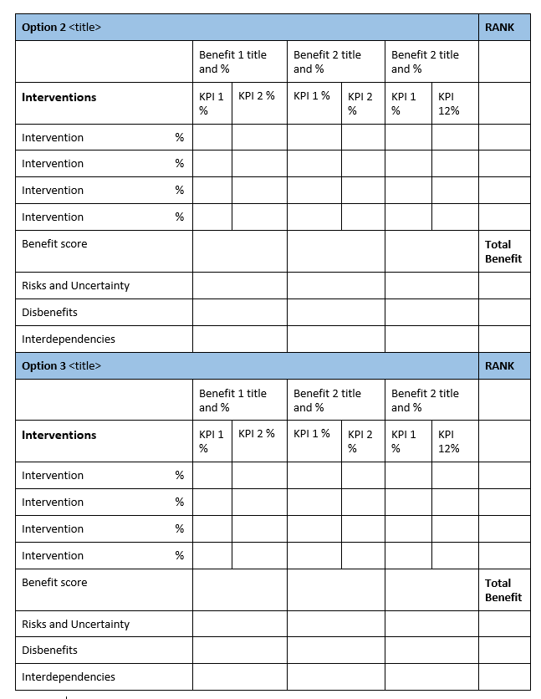
Create option range and describe the focus of each option
Identify potential interventions for each option
Start with Option 1 – Do Nothing/Business as Usual option. The intervention here will be something like 'Continue to…' and is usually weighted at 100%. You will not need to draw a full table for this option, just identify the disbenefits later in the workshop.
Then move on to Option 2 – review the initial intervention list that was circulated with the pre-workshop preparation.
Ask whether any of these interventions are important to this particular response.
Next consider what other interventions should be included. These could be new and may be developed for the first time in the workshop.
When describing each intervention make a note of a couple of bullet points that might provide a better idea of the attributes of the intervention.
Test these interventions to see whether you have considered demand, productivity and supply.
Allocate percentage weighting to each intervention out of 100%
Notes:
29

Slide 31
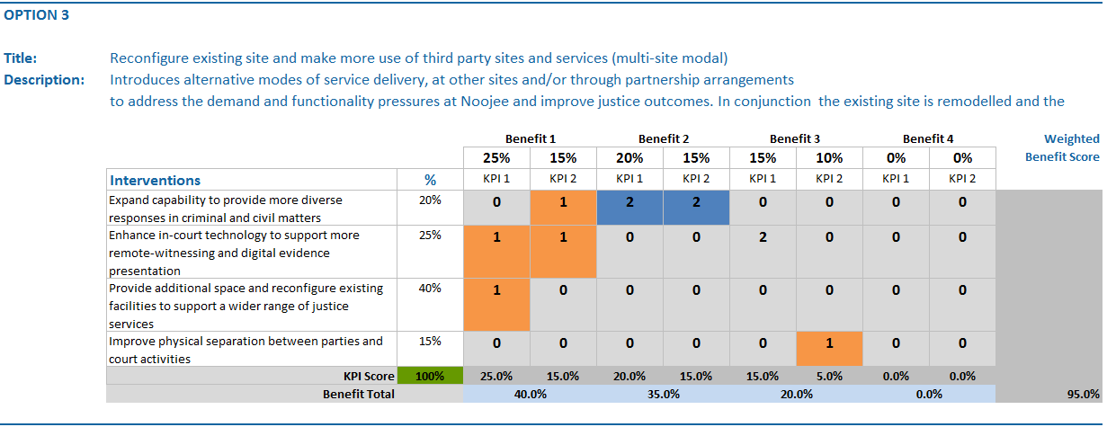
Determine interventions and KPI alignment
Assess each intervention in terms of its delivery of KPIs
Score: 0 = Marginal. This intervention contributes only marginally to the KPI, or not at all
1 = Partial. (Orange)This intervention makes a meaningful contribution to the KPI
2 = Full. (Blue) This intervention makes a substantial contribution to the KPI and is the overarching mechanism that will deliver the KPI.
Each KPI can only receive a maximum of two and have no more than two interventions that contributes to the KPI
Calculate the weighted KPI score and then total all scores to arrive at a weighted benefit score.
Notes:
30

Slide 32
Evaluate options
Criteria
Assess options
Risk and uncertainty
Identify the primary 2-3 risks that the benefits will be not be delivered and assess based on consequence’ and ‘likelihood’ high, medium or low ( H,M,L)
Identify if there are any other potential shifts in the organisation’s current or future operating environment -demographic, economic, environmental, social, political, industry or technological factors, which, if they occurred would fundamentally change the investment’s benefit delivery
Dis-benefits
Identify 1-2 disadvantages that will result, as a direct result of the successful delivery of the investment. Assess their criticality H,M,L
Interdependencies
Identify whether any of the interventions have any interdependencies. These should be ranked with a H, M,L impact
Real options
Determine whether Real options analysis should be considered if the investment proceeds to full business case Yes/No/Maybe
May be recommended when primarily asset investments are significant, high cost and complexity and have a medium – long lifecycle
Notes:
31

Slide 33
Determine initial rankings
Identify the preferred response
Finalise the workshop
Rank options 1,2,3….
Review the options and confirm that the range and assessment is meaningful and genuine
Ask which options should proceed to be analysed further as part of a business case. It is usual to have 2 or 3 options as well as the Do Nothing that require further investigation
Outline feedback process and timeframe.
After the workshop complete the worksheets in the ROAR workbook
Indicate that further analysis of cost and time will be conducted after the workshop and prior to the Solution Definition workshop where the preferred response will either be validated or replaced with another. This will be used to generate a recommended solution.
Ensure that before the next workshop
the cost and timeframe data is completed well in advance of the Solution Definition workshop
the Response Options Analysis Report, and worksheet has been updated.
The ranking of responses and confirmation of the preferred response will be tested and confirmed at the Solution Definition workshop
Notes:
32

Slide 34


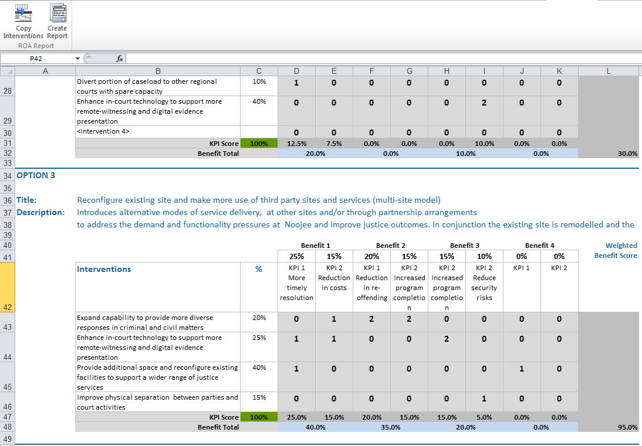
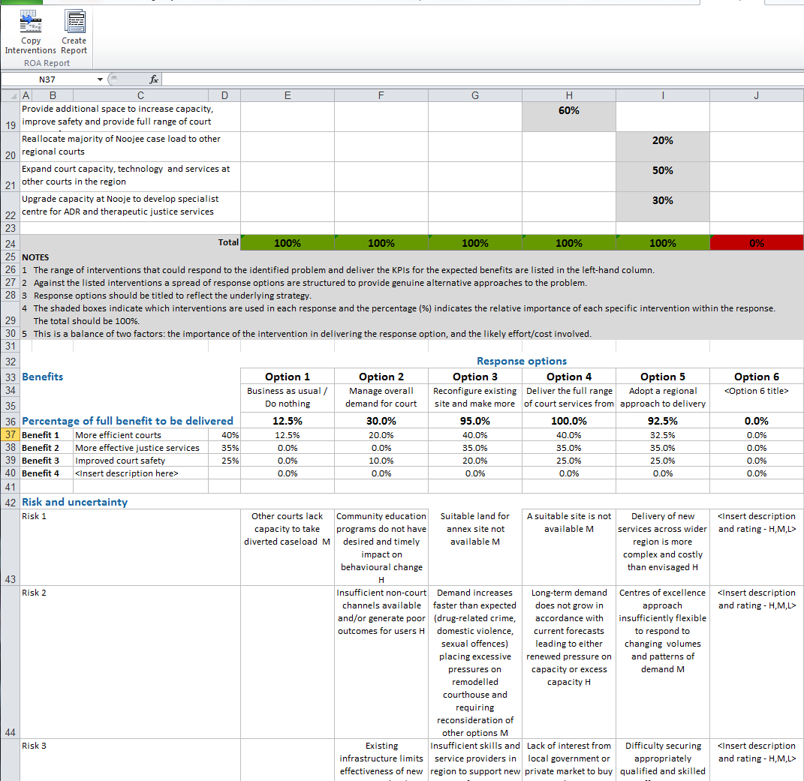
Complete the Response Options Analysis Report
Select copy interventions button to populate worksheet 2
Select create report button to generate a Word version of the report

Slide 35
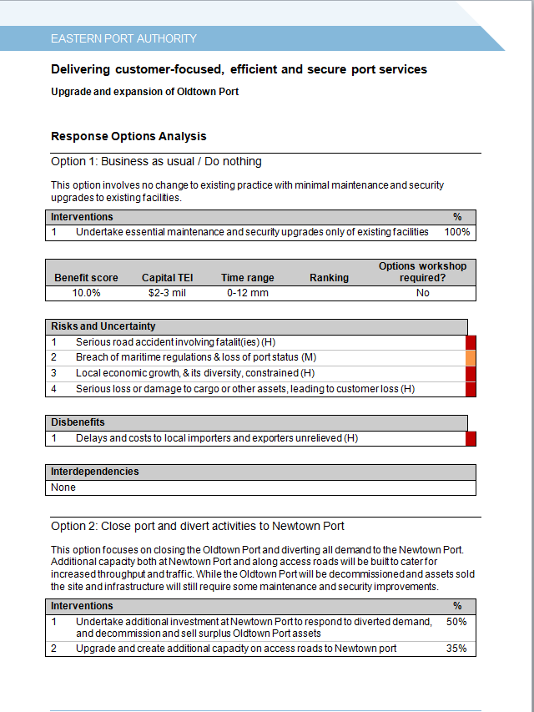
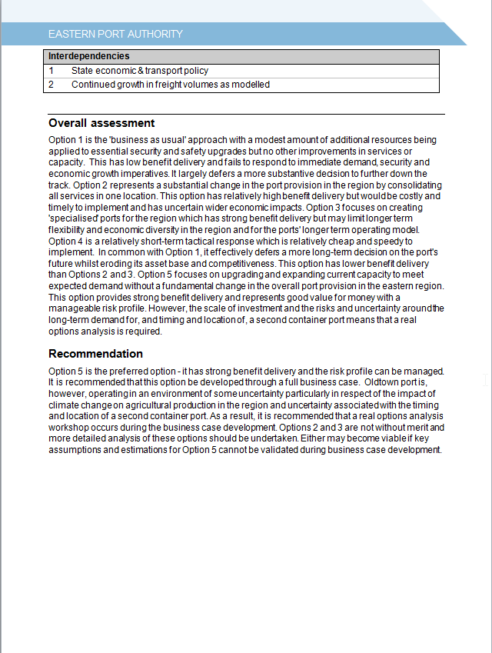
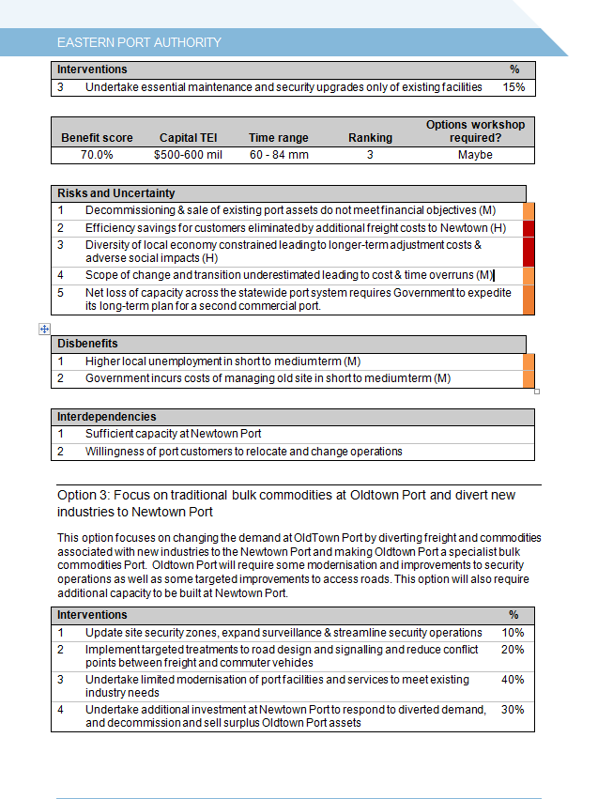

Slide 36
Solution definition workshop
Shaping and recommending an indicative solution
Focus on reviewing options in the light of cost and timeframe data. This provides a more informed view of cost and value for this investment.
Describe and assess a new option if one emerges.
Rank options and select the recommended option.
Detail the ‘best likely’ solution and test that it is likely to be delivered within time and budget constraints
Ensure that the solution can be applied flexibly to manage and respond to uncertainty and adapt to changing conditions and demand
Review the problem definition to confirm that the right investment need has been identified, and that the preferred solution is likely to support this need given a range of alternative future scenarios.
Consider the whether there are any conditions in which the preferred solution may be sub-optimal, you would prefer a different approach, or would regret the selected solution.
Shaping a new investment provides an opportunity to challenge the way government has solved problems in the past. Whilst tried and tested approaches may indeed be the best way to proceed, it is vital that decision-makers explore other responses which may be more effective, adaptable, or enduring.
Notes:
35

Slide 37
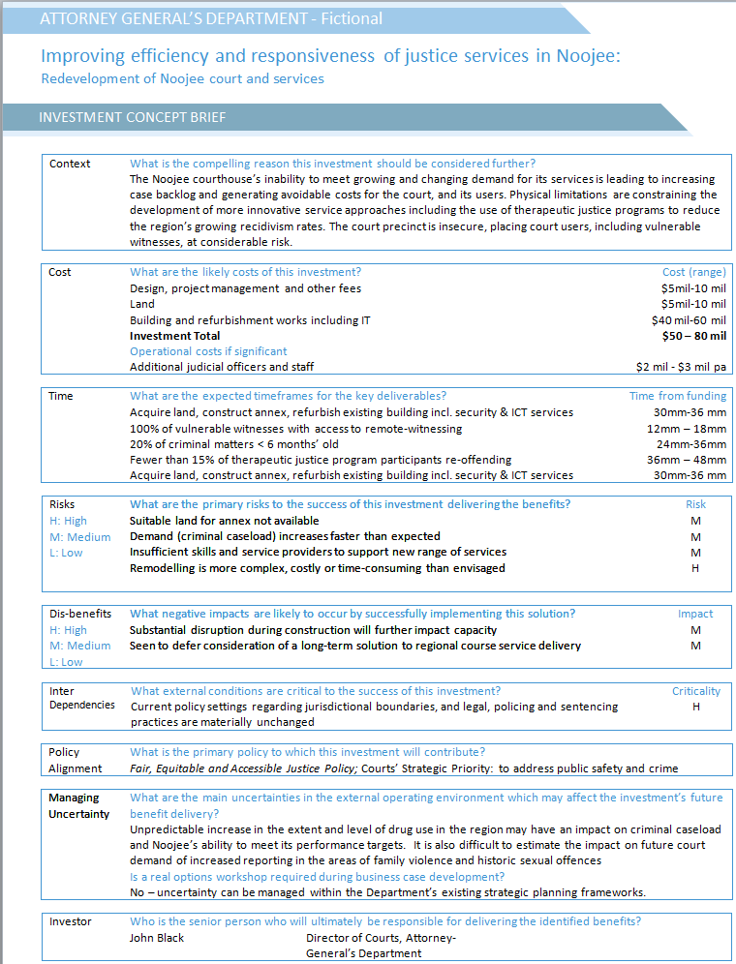
Investment Concept Brief
Risks, Disbenefit, Interdependencies Assessed as High, Medium, Low for level of Risk, Criticality, Impact.
Policy alignment Nominate the primary policy of government or organisation to which this investment is responding. Also consider whether there are other policy levers such as value capture and creation, climate change policy that should be highlighted here.
Managing Uncertainty Record whether there are any circumstances or future scenarios in which the preferred solution would be less successful in delivering the planned benefits or would lead to investment regret; and whether the preferred solution enables Government to respond flexibly to changing circumstances, minimising Government’s obligations under unfavourable conditions or enabling opportunities for benefit enhancement to be leveraged.
Will a real options analysis be needed, if this investment proceeds to full business case?
If it has been recommended for the related response option, it is almost inevitable that this recommendation will roll-forward into the ICB.
Notes:
36

Slide 38
Shape the solution
Best likely solution
Understand the solution
Ask the solution architect to explain changes and assets and what other solutions were considered
Test whether the investment is cost-effective
Test whether the solution is innovative and smart
If the solution has not been defined then focus on each intervention and ask 'What could we do here?'
Test whether the solution is flexible enough to respond to identified uncertainty
Test the logic flow back to delivery of KPIs and resolution of Problems
Establish cost range for individual changes and assets or in some instances bundles of changes and asset that make sense
Confirm the circumstances (change in condition or an event) where the preferred response may be inadequate or inappropriate, and the triggers requiring a change in solution
Is the solution still a smart way to proceed?
Notes:
37

Slide 39
Key questions
Does the logic flow?
  Do these changes and assets, if required, align with our interventions?
  Will they deliver the benefits and KPIs?
  Will the solution address the problems outlined in the ILM?
Is the investment cost-effective?
  Can this investment be used to provide capabilities or assets that others might use in the future?
  Are there capabilities or assets in existence that might be used as part of the solution?
  Does it align with the organisation’s policies, strategies and architectures?
Is the solution innovative and smart?
  Is it innovative in the way it seeks to solve the business need?
  Does the proposed solution take advantage of new thinking and technologies?
  Is it sound and feasible from an implementation perspective?
  Are there any circumstances in which you would seek an alternative, and materially different, course of action? –
  If ‘yes’, the ICB should note that a real options workshop may be required.
Will the solution be flexible enough to respond to identified uncertainty?
Have opportunities for building flexibility into the investment to mitigate future uncertainty been considered? If ‘no’. the ICB may need to note that a real options workshop may be required.
Notes:
38

Slide 40
Conclude the workshop
If participants do not identify significant uncertainty and real options analysis is not considered warranted, the group must undertake a feedback loop at the end of the Solution Definition workshop.
Review the Decision-maker’s Checklist and test:
  Has the investment need been correctly defined – are we considering the right problem?
  Under what conditions would the preferred solution be a sub-optimal response?
  Under what conditions would an alternative investment strategy be preferred?
  Under what conditions would we regret this investment?

Slide 41
IMS Quality Assurance Facilitation Services
Provided By Eldar Salkovic
Innox Solutions

Slide 42
What IMS services we provide
Rigorous reviews of the quality of IMS materials received for accreditation and re-accreditation, in accordance with DTF specified criteria and quality standards;
Giving written and verbal feedback on each submission to the applicants, ensuring that the candidates are able to increase their understanding of the IMS and improve the quality of their work; and
Provision of external IMS material review services.

Slide 43
Ensuring the development of high quality ILMs…
Story telling | Ensure the use of plain English throughout the investment story
Problem | Keep the problem statements focused whilst ensuring that they have been pitched at the right level. Deploy appropriate enquiring techniques such as problem trajectory, root cause analysis and 5 whys. Try and avoid using asset and compliance failures or high risk as causes. In most cases they will diminish the investment story and lock you into a solution prematurely. Instead aim to focus on service failures.
Benefit | Ensure benefits and KPI’s have a reasonable and logical connection to the problem statements.
Interventions | Ensure interventions are focused enough as to give the reader an indication of what specific strategic levers are being deployed to address the problem and deliver the benefits. Avoid pitching them too high, have them solution focused or too few in numbers

Slide 44
Additional Facilitator Support
Online Facilitator Forum
Facilitators discuss their experiences and learning’s on conducting successful IMS workshops.
https://www.innoxsolutions.com/forum
Future release of a designated Facilitator Blog
A dedicated blog that aims to identify best-practice approaches to exploring root causes to problems, defining benefits and associated KPI's, as well as a wide range of valuable information relating to IMS.

Slide 45
Contact information
Eldar Salkovic
Innox Solutions
m: 0406 944 957
e: eldar@innoxsolutions.com
w: www.innoxsolutions.com

